Slide 1
Bioinformatics Capstone
Evaluating Properties of Bacteria Isolated from UVU’s Campus

Slide 2
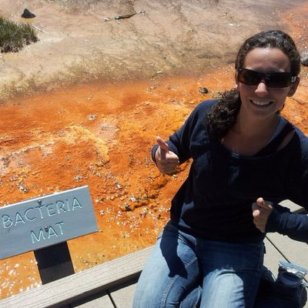
Essential Info About Me
Background in Environmental Science
BS Marshall University – Go Herd!
MS Yale School of Forestry and Environmental studies
PhD in Microbiology at Oregon State University
Postdoc (i.e., poorly paid researcher) at University of California, Merced for ~2 years
UVU since 2018

Slide 3
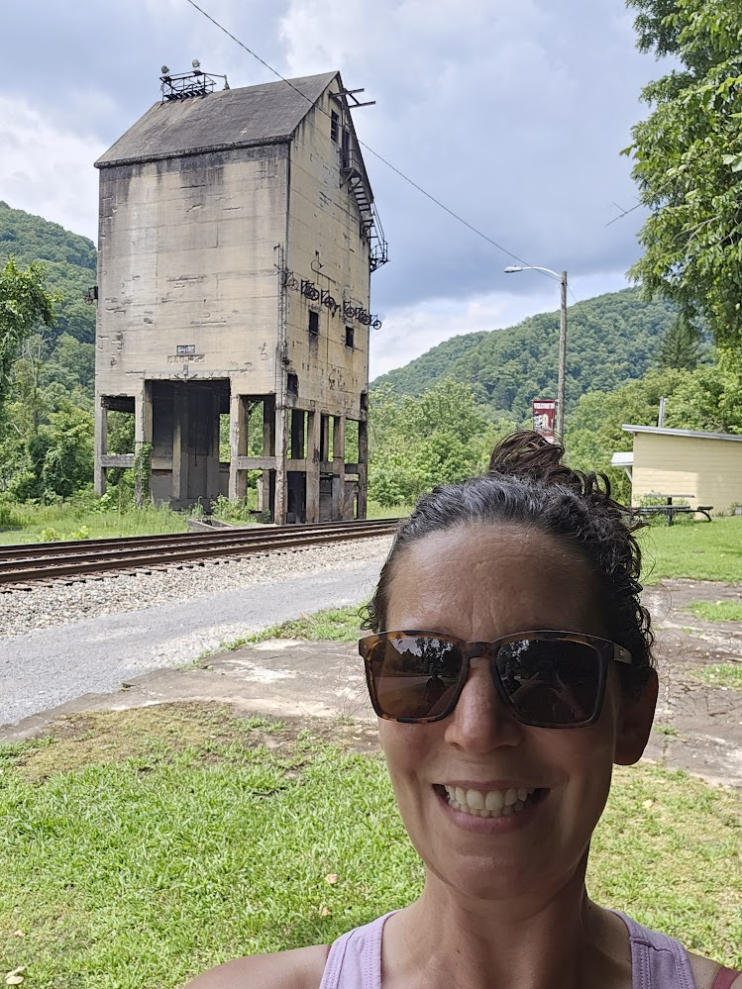
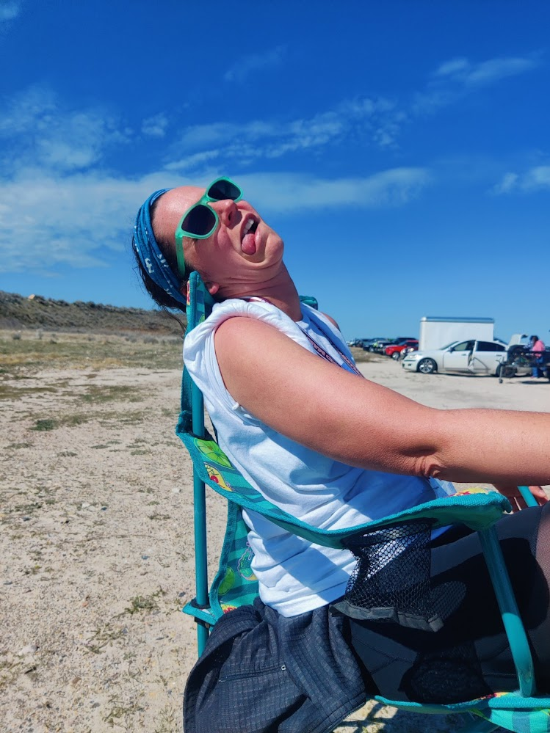
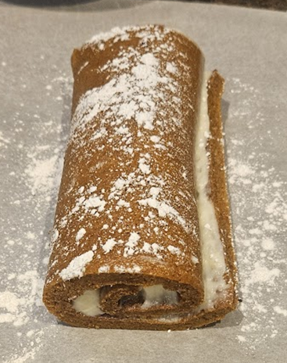
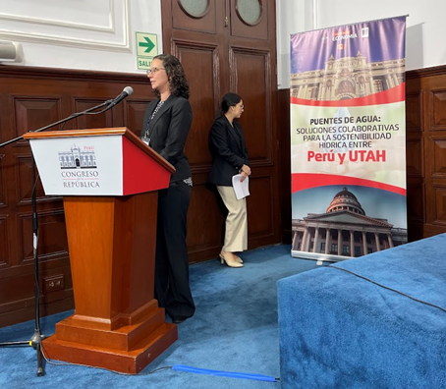
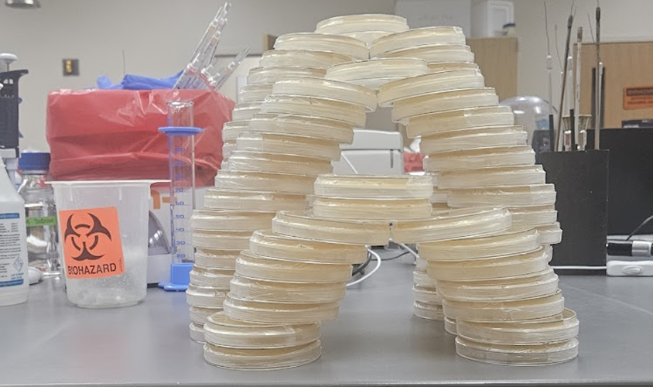
Other fun facts
West Virginian
Chronically Injured Runner
Baker of anything with butter and sugar
Passionate about the environment
Always recruiting research students

Slide 4
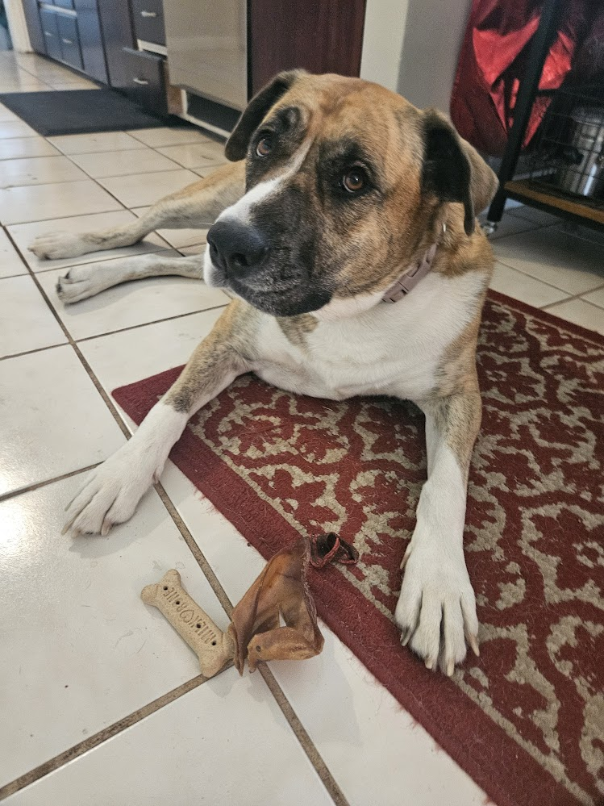
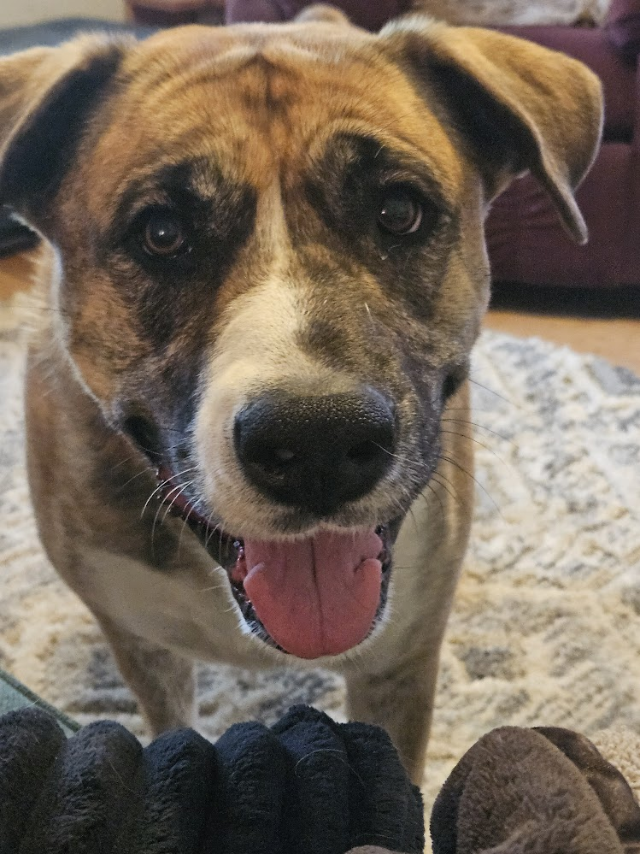
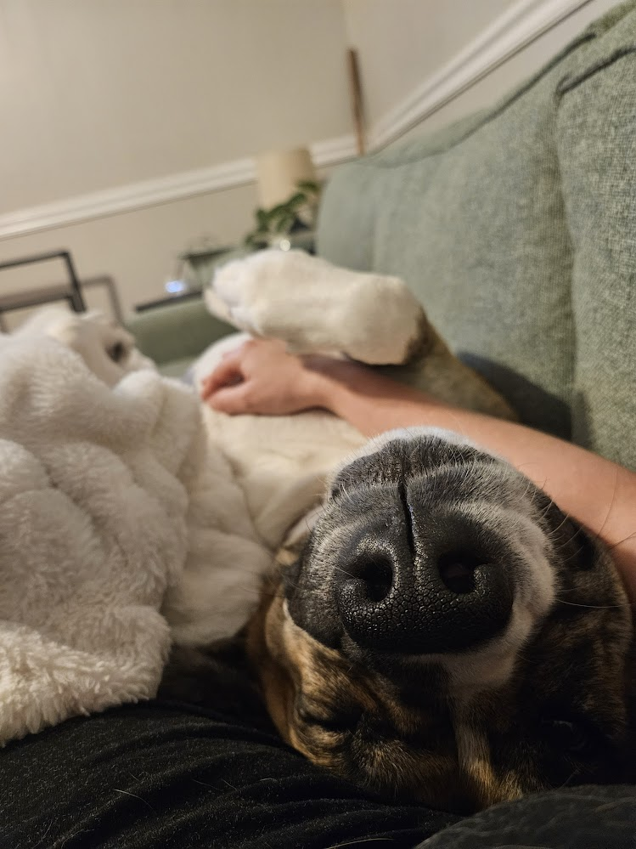
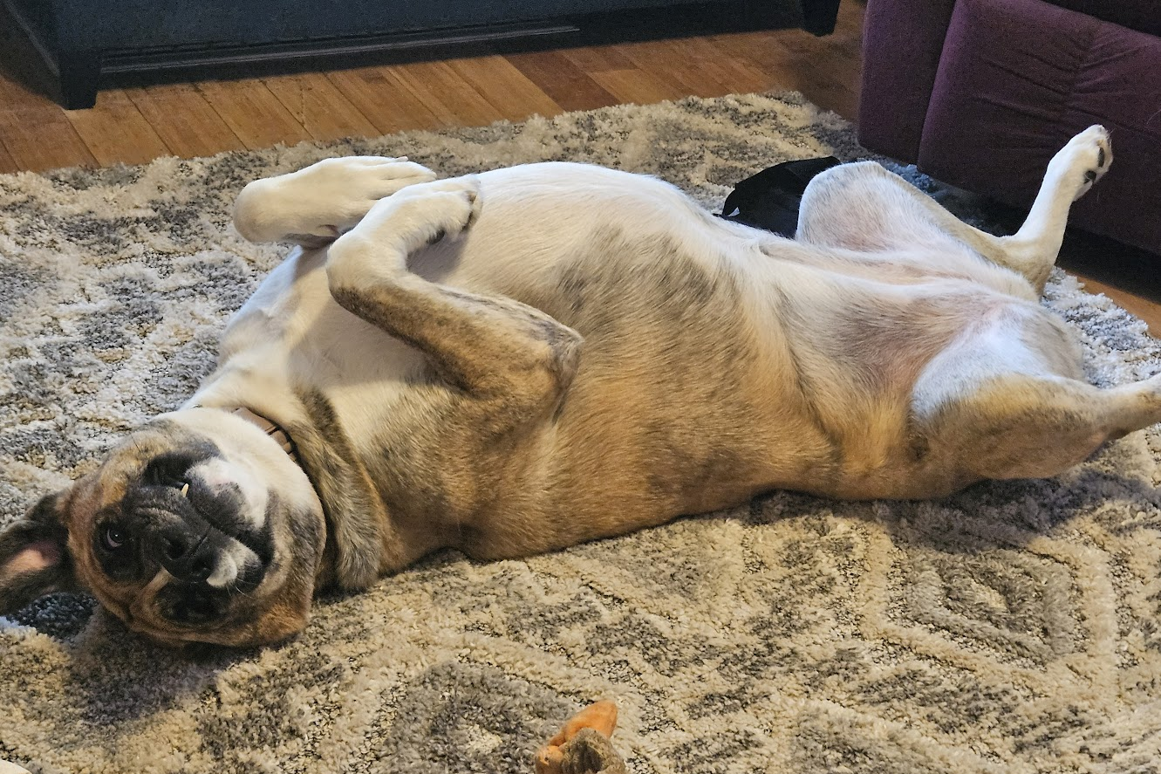
Most importantly…

Slide 5
Project History
Concept Formation
Pre-2021
Individuals Involved:
- Mo Kaze*
- Mark Sistrom*
Bacteria Isolation
2021
Individuals Involved
- Shelby Smith*
- Riley Smith
- Spencer Leavitt
- Trent Groesbeck
Sequence Generation
2024 - Current
Individuals Involved
- Tyler LeBaron*
- Davis Stobbe*
*Denotes individuals who (potentially) warrant authorship

Slide 6
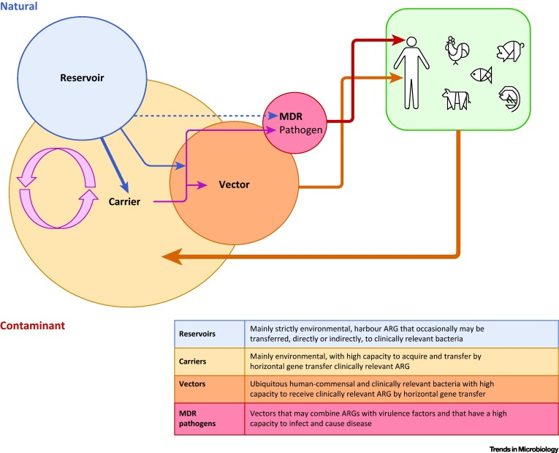
Concept Formation
Assessing the Risk of Antibiotic Resistance Transmission from the Environment to Humans: Non-Direct Proportionality between Abundance and Risk
https://www.cell.com/trends/microbiology/fulltext/S0966-842X(16)30191-3

Slide 7
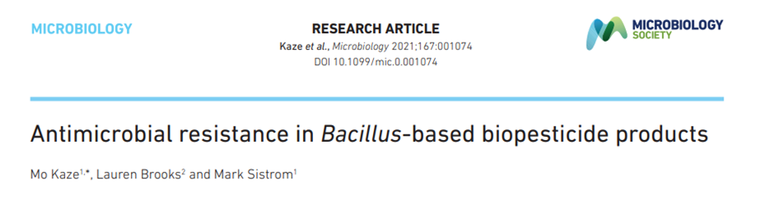
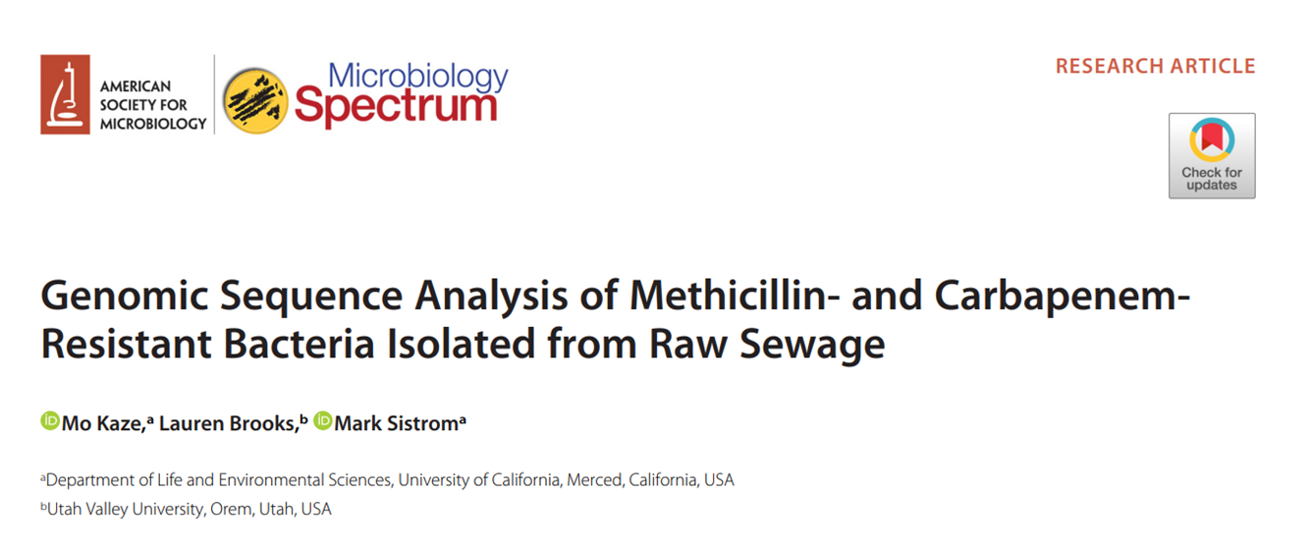
Concept Formation
Antimicrobial resistance in Bacillus-based biopesticide products
https://www.microbiologyresearch.org/content/journal/micro/10.1099/mic.0.001074
Genomic Sequence Analysis of Methicillin- and Carbapenem-Resistant Bacteria Isolated from Raw Sewage
https://journals.asm.org/doi/full/10.1128/spectrum.00128-21

Slide 8
Pre-2021: Concept Formation
Questions:
Do we observe “environmental bacteria” in our built environment that could act as reservoirs/carriers/vectors of genes of interest?
Are these bacteria capable of exchanging these genes of interest with pathogenic species?

Slide 9
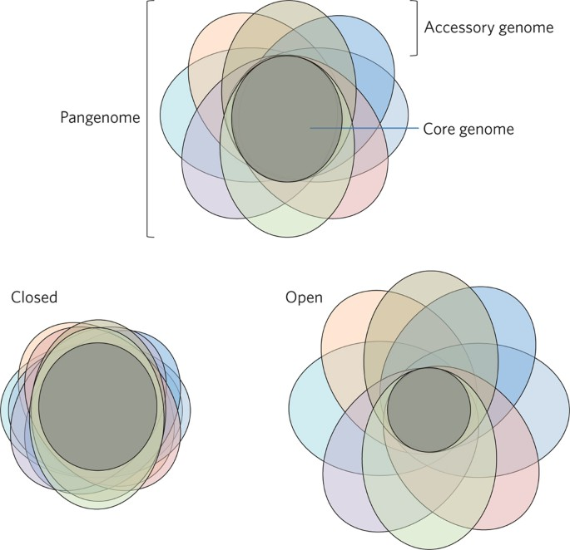
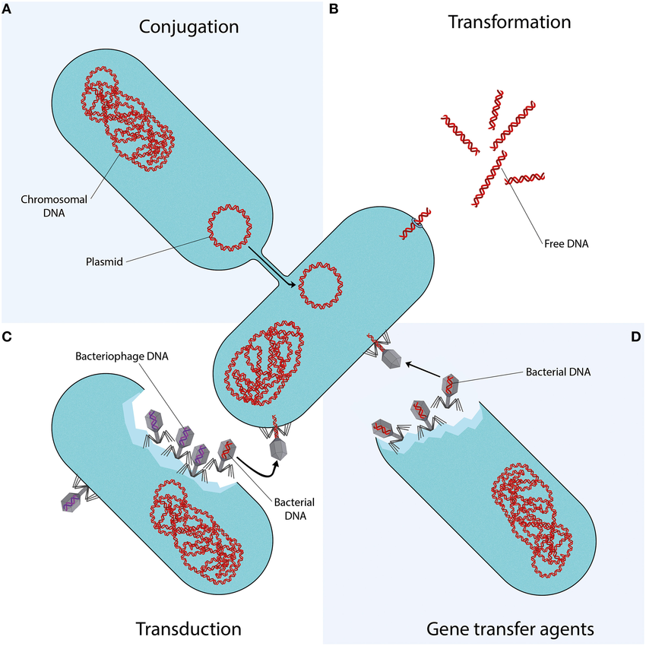
Background information: Bacterial Genome Evolution
Why prokaryotes have pangenomes
https://www.nature.com/articles/nmicrobiol201740
Dissemination of Antimicrobial Resistance in Microbial Ecosystems through Horizontal Gene Transfer
https://www.frontiersin.org/journals/microbiology/articles/10.3389/fmicb.2016.00173/full

Slide 10
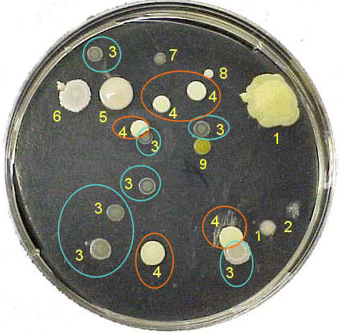
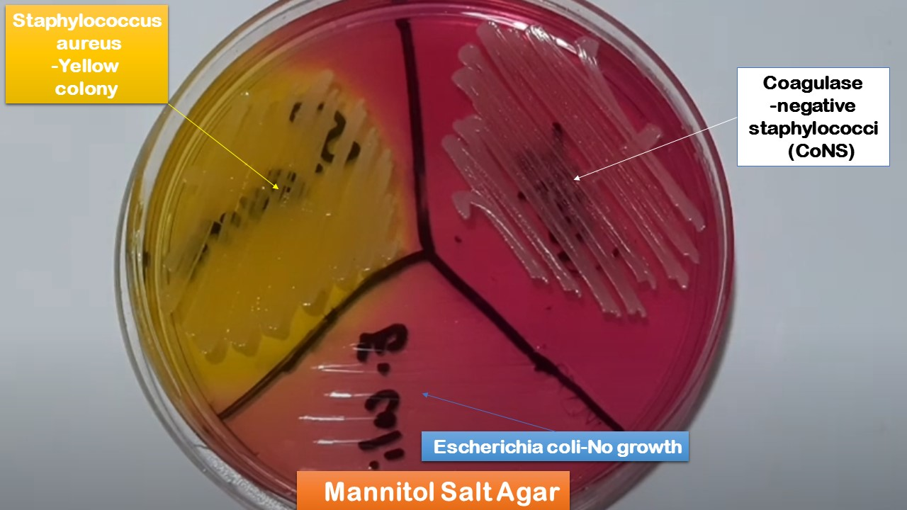
Bacterial Isolation
Swab Surface
Select “yellow” colony
Repeat 3x to ensure isolation
Evaluate Properties of Isolate

Slide 11
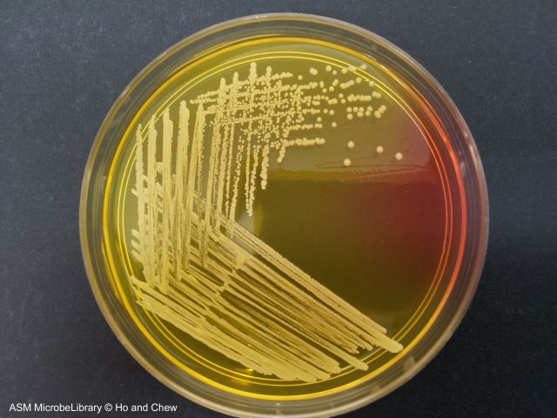
Bacterial Isolation
Swab Surface
Select “yellow” colony
Repeat 3x to ensure isolation
Evaluate Properties of Isolate

Slide 12
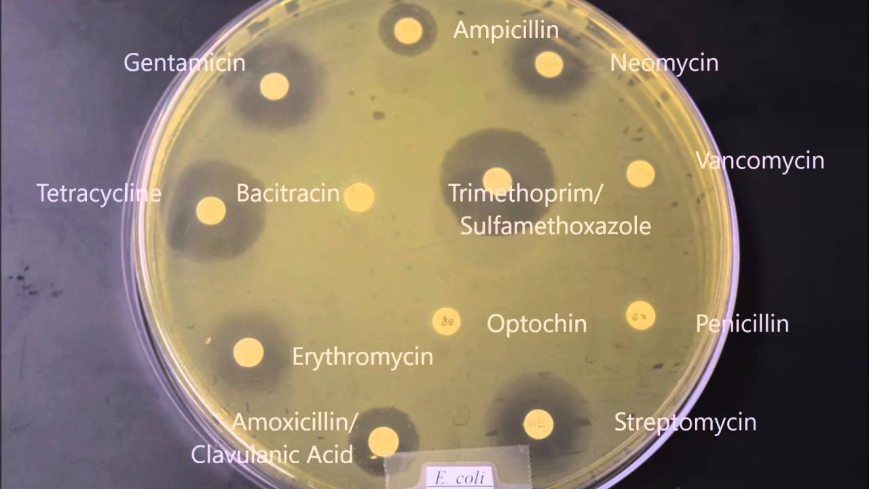
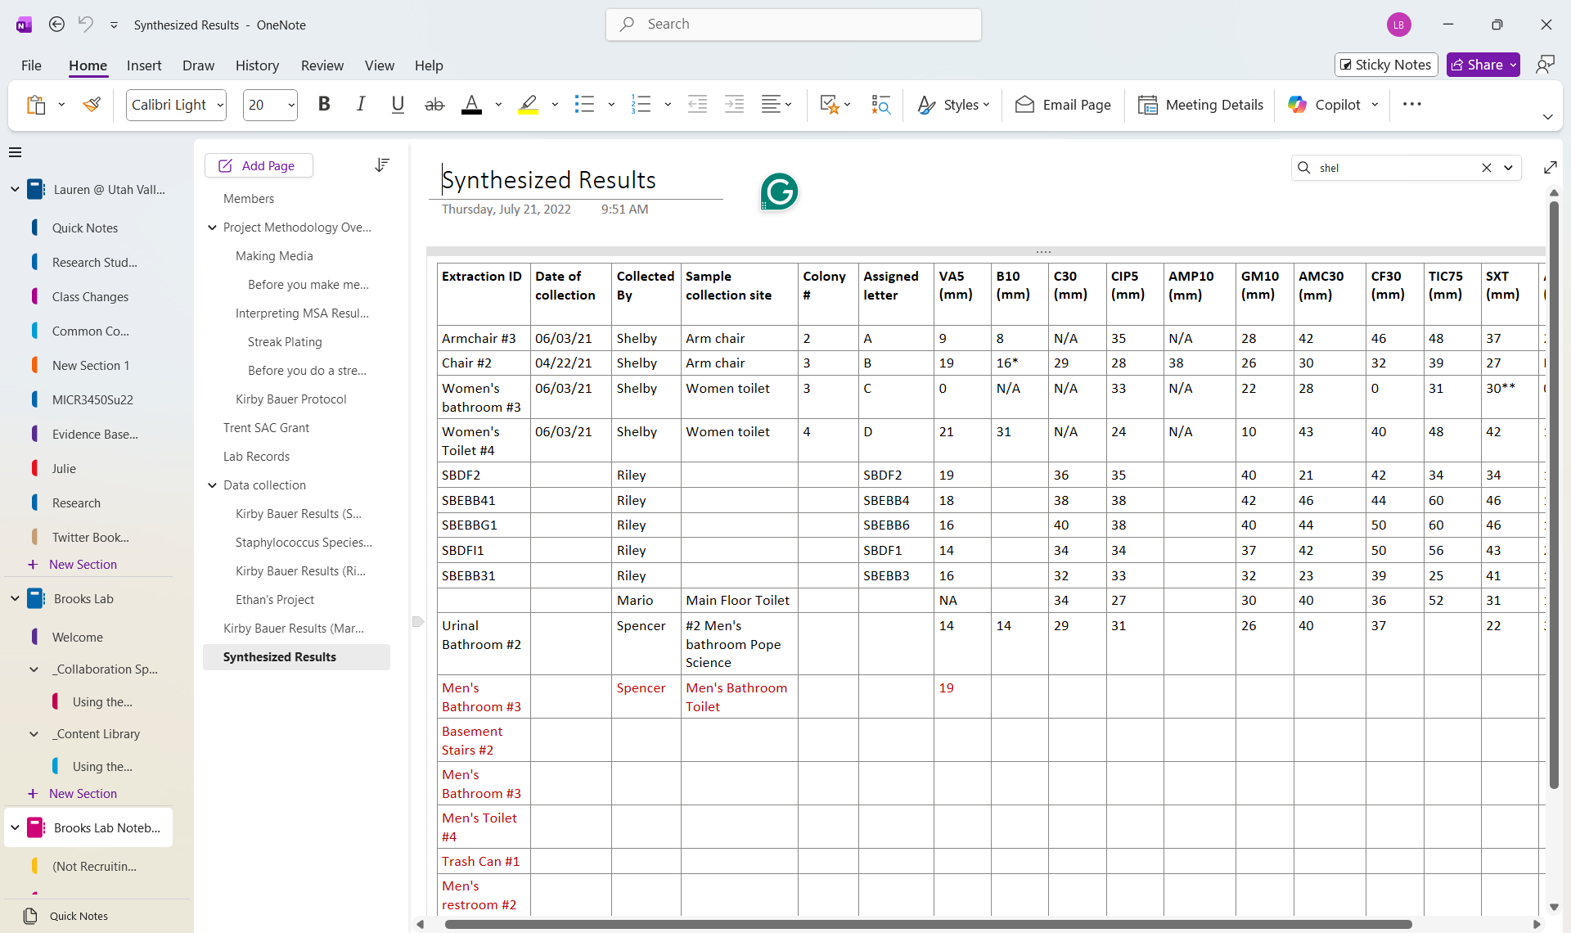
Bacterial Isolation
Swab Surface
Select “yellow” colony
Repeat 3x to ensure isolation
Evaluate Properties of Isolate

Slide 13
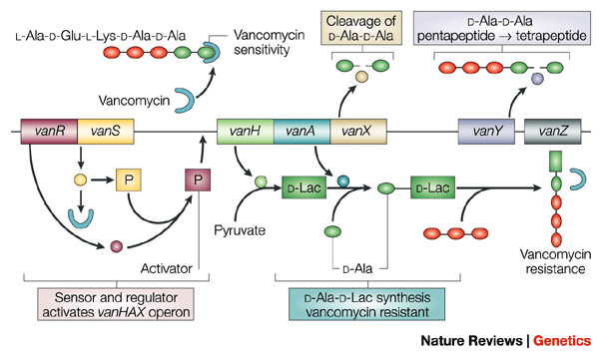
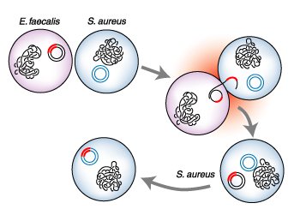
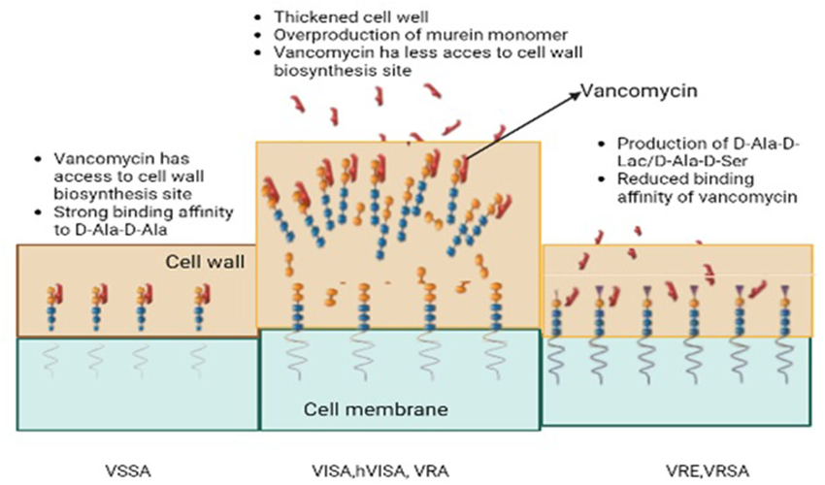
Project Cancellation
Exploiting genomics, genetics and chemistry to combat antibiotic resistance
https://www.nature.com/articles/nrg1084
Vancomycin drug resistance, an emerging threat to animal and public health
https://www.frontiersin.org/journals/veterinary-science/articles/10.3389/fvets.2022.1010728/full
A Bacterium's Borrowed Weapon
https://www.science.org/content/article/bacteriums-borrowed-weapon

Slide 14
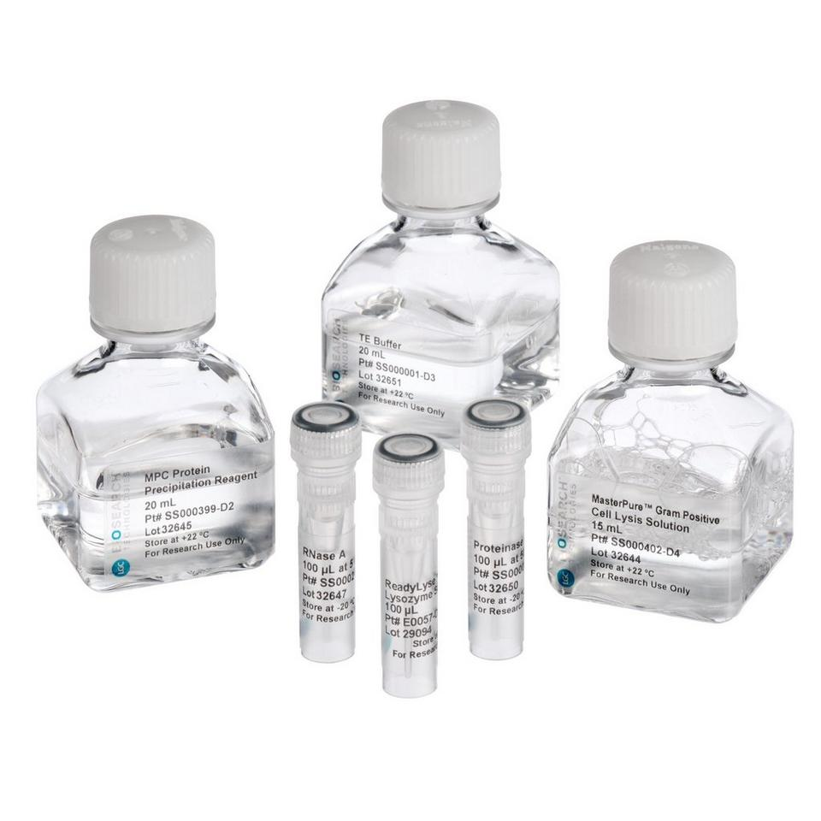
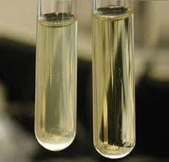

Sequence Generation
Liquid Culture of Bacteria
DNA Extraction
Mail to SeqCenter

Slide 15

Sequence Generation
https://www.seqcenter.com/service/illumina-dna-sequencing/illumina-whole-genome-sequencing/

Slide 16
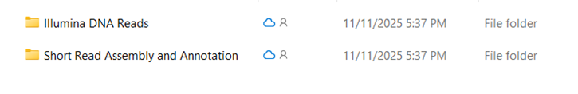
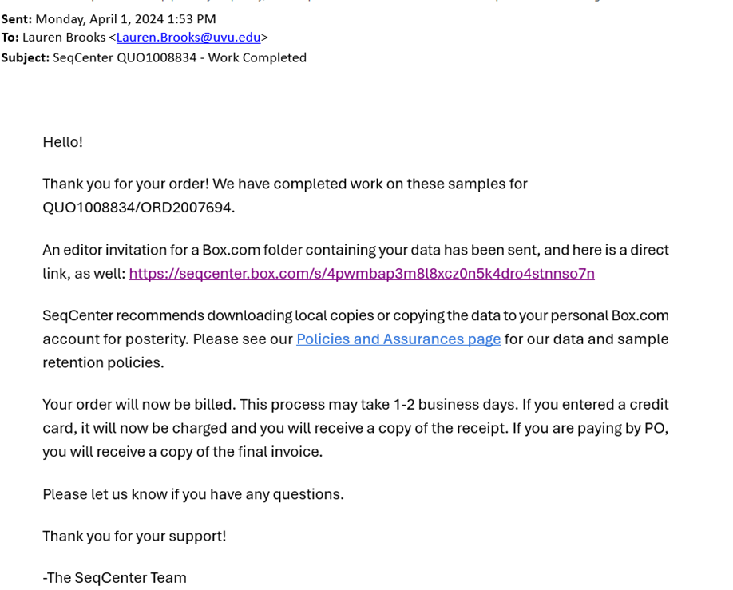
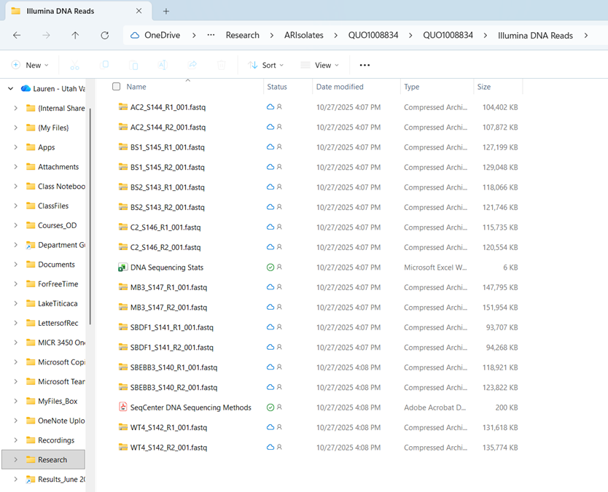
Output:

Slide 17
Your Tasks (using raw data output from SeqCenter):
Take output from SeqCenter and Analyze
Data evaluation and Quality Control
Genome Assembly
Genome Annotation
Comparative Genomics
Detecting Additional Features
You’ll be asked to complete scaffolding and reflection assignments along the way!

